Slide 1
Colour Picking Robot
CSE221 – MICROPROCESSOR AND INTERFACING

Slide 2
Team Members:
D. Shashank – 13BCE1036
Harshwardhan Agarwal – 13BCE1052
S. Nikesh Kumar Reddy – 13BCE1136

Slide 3
Abstract
One of the most wonderful creations by human is the automaton and its derivation, robot.
Automatizing things give us many benefits such as accuracy, time saver, specifications and what not.
One such robot is a color picking robot. It has a wide range of applications in day to day life.
For an instance, A car which has an automatic driving/ auto pilot mode in it need to detect color in order to change its mode during the signals, A device separator in a product manufacturing factory need to have a color picking robot(expanded with additional features) to separate things etc.

Slide 4
Colour Sensor
A crucial part of color picking robot is sensing/detecting the color. We could use a sensor for the purpose but by using a sensor, there is no purpose of doing the project because if we have the sensor, we just need to assemble things. So we need to build a sensor and detect colors using it.
We perform this operation using an Arduino.

Slide 5
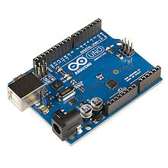
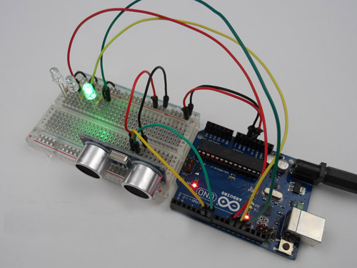
Arduino
It is an open source hardware, software and user interface that can be used for designing/manufacturing interactive objects which can sense or control the physical world.
An Arduino board consists of an Atmel 8-bit AVR microcontroller with complementary components that facilitate programming and incorporation into other circuits.

Slide 6
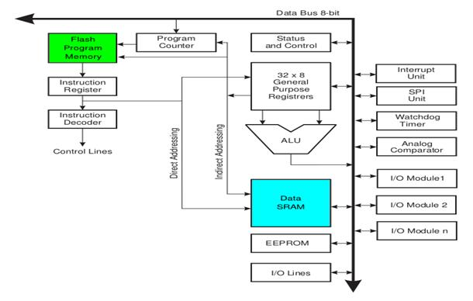
Working of an Arduino
It has 14 digital input/output pins (of which 6 can be used as PWM outputs), 6 analog inputs, a 16 MHz ceramic resonator, a USB connection, a power jack, an ICSP header, and a reset button. It contains everything needed to support the microcontroller; simply connect it to a computer with a USB cable or power it with a AC-to-DC adapter or battery to get started.

Slide 7
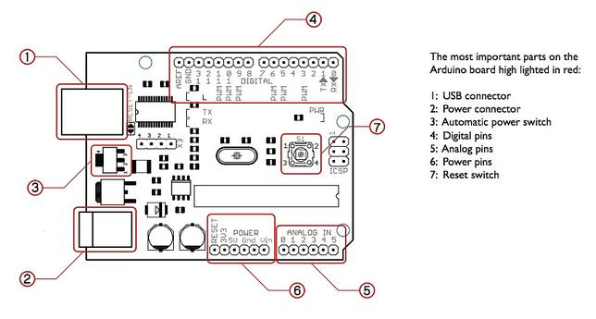

Slide 8
How to program in an arduino
The most important advantage with Arduino is the programs can be directly loaded to the device without requiring any hardware programmer to burn the program. This is done because of the presence of the 0.5KB of Bootloader which allows the program to be burned into the circuit. All we have to do is to download the Arduino software and writing the code.
Programs written in Arduino are known as sketches. A basic sketch consists of 3 parts
1. Declaration of Variables 2. Initialization: It is written in the setup () function. 3. Control code: It is written in the loop () function.
The sketch is saved with .ino extension. Any operations like verifying, opening a sketch, saving a sketch can be done using the buttons on the toolbar or using the tool menu.
The sketch should be stored in the sketchbook directory.
Chose the proper board from the tools menu and the serial port numbers.
Click on the upload button or chose upload from the tools menu. Thus the code is uploaded by the bootloader onto the microcontroller.

Slide 9
Advantages of arduino
It is inexpensive
It comes with an open source hardware feature which enables users to develop their own kit using already available one as a reference source.
The Arduino software is compatible with all types of operating systems like Windows, Linux, and Macintosh etc.
It also comes with open source software feature which enables experienced software developers to use the Arduino code to merge with the existing programming language libraries and can be extended and modified.
It is easy to use for beginners.
We can develop an Arduino based project which can be completely stand alone or projects which involve direct communication with the software loaded in the computer.
It comes with an easy provision of connecting with the CPU of the computer using serial communication over USB as it contains built in power and reset circuitry.

Slide 10
Specifications of Arduino
Microcontroller ATmega328
Operating Voltage 5V
Input Voltage (recommended) 7-12V
Input Voltage (limits) 6-20V
Digital I/O Pins 14 (of which 6 provide PWM output)
Analog Input Pins 6
DC Current per I/O Pin 40 mA
DC Current for 3.3V Pin 50 mA
Flash Memory 32 KB (ATmega328) of which 0.5 KB used by bootloader
SRAM 2 KB (ATmega328)
EEPROM 1 KB (ATmega328)
Clock Speed 16 MHz
Length 68.6 mm
Width 53.4 mm
Weight 25 g

Slide 11
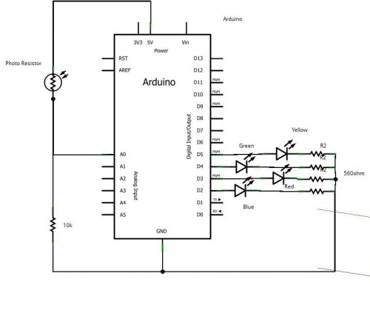
Schematic of the color sensor

Slide 12
Components required
Photo resistor
10k ohms resistors
Arduino
Connecting wires
Led (blue,red,green,yellow)
Breadboard

Slide 13
ARDUInO CODE
The code for Arduino is provided in the attached word document file.

Slide 14
Thank you

